Slide 1








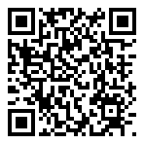
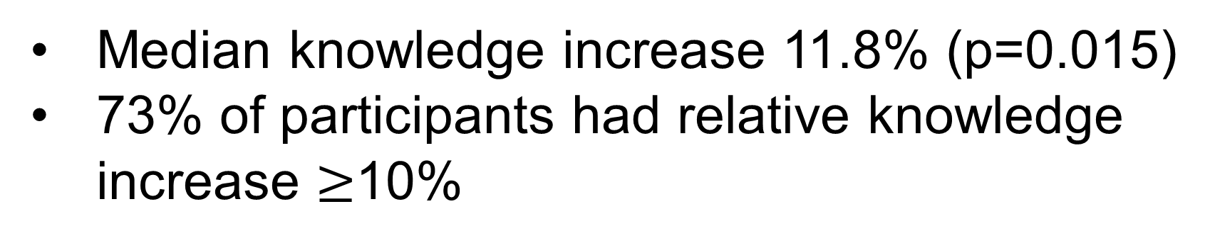
Pilot testing of PREPARE for Autistic Adults: An adult autism training for resident physicians designed with autistic adults and family members
COLLEGE OF MEDICINE
Brittany Hand, Daniel Gilmore, J Madison Hyer, Holden DeVassie, Deondray Radford, PREPARE for Autistic Adults Advisory Board, Lisa Juckett, Christopher Hanks, Susan M. Havercamp, Daniel Coury
Introduction
Contextual, conceptual frameworks
Presentation
Case study
Patient-centered care
Presentation
Case study
Clinical assessment
Presentation
Case study
Feasibility, acceptability, appropriateness
Discussion
National Council on Disability recently urged ACGME to require disability trainings in residency¹
Lack of physician autism training yields: limited knowledge and low self-efficacy in delivering care for adults.
To address this gap, we developed Promoting Residents’ Excellence in Patient-centered cARE (PREPARE) for Autistic Adults⁵
SP #1
 | Median (IQR)
Feasibility | 5 (4, 5)
Acceptability | 5 (4, 5)
Appropriateness | 5 (4, 5)
<50% of physicians have high self-efficacy in caring for patients with disabilities⁶
Disability trainings are one way to address this
Preliminary evidence that PREPARE for Autistic Adults:
Has good completion rates
Is feasible, acceptable, and appropriate
Significantly improved residents’ knowledge about caring for autistic adults
Next steps include…
Team-based practice
Legal obligations
Care over lifespan, transitions
Presentation
Case study
Presentation
Case study
Presentation
Case study
Autism knowledge
SP #2
 | Median (IQR)
Pre-test knowledge | 67.6 (58.8, 76.5)
Post-test knowledge | 76.5 (67.6, 82.4)
Low self-efficacy²
Limited knowledge³
Lack of
flexibility⁴
Measures: Completion rate, Feasibility of Implementation Measure (FIM), Acceptability of Implementation Measure (AIM), Implementation Appropriateness measure (IAM), autism knowledge (17-items), qualitative interviews
Data Analysis: Descriptive statistics, Wilcoxon signed-rank test, Rapid thematic analysis
Median knowledge increase 11.8% (p=0.015)
73% of participants had relative knowledge increase $≥$10%
Thematic analysis results
Theme: Flexibility facilitates feasibility
Revise training
Waitlist controlled trial
Publicly share training
Objectives
Representative quote: “I think you definitely provided plenty of times which was, I think, crucial.”
Example changes made: Offer earlier times; offer training multiple times throughout year
Acknowledgements
Evaluate participants’ completion rates
Evaluate feasibility, acceptability, and appropriateness
Obtain feedback from participants to improve implementability
Results
Theme: High-value experiences increase acceptability
Advisory board: Gyasi Burks-Abbott; Carolyn Harper-Munnerlyn; Ace Patrick Unruh; Jennifer Strobel; Amy Hwa Frechette, BA; Cindy Molloy; Nicole LeBlanc; Jennifer Samuel; Sal Silinonte, Consulting Autistic.
Funding: Department of Defense (W81XWH-22-1-0248); NCATS (UM1TR004548)
Participant characteristics
Representative quote: “I felt like I really liked those one or two minutes of, ‘This is why the thing that you're learning about is really important when it comes to me and my life,’ because it provided insight.”
Additional feedback: Hearing from autistic adults is a rich experience; training was safe space to leave comfort zone
 | N (%)
Residency type
Internal Medicine | 3 (21.4)
Family Medicine | 5 (35.7)
Internal Medicine/Pediatrics | 6 (42.9)
Relationship to autistic people
Family member is autistic | 3 (21.4)
Friend is autistic | 4 (28.6)
Theme: Other practicalities affecting implementation
Representative quote: “There was an organized website that let me just go there and if I can't find it in my email, if I can't find it anywhere else, I know where I can find it. That was very helpful.
Example changes made: Add prompt for SP encounter; add resources handout; clarify “muddy points”
References
Methods
Completion rates
Gallegos A. NCD Letter to the ACGME Regarding Disability Competency Training of Medical Professionals. Published online July 16, 2021. https://ncd.gov/publications/2021/ncd-letter-acgme-regarding-disability-competency-training-medical-professionals
Nicolaidis C, et al. “Respect the way I need to communicate with you”: Healthcare experiences of adults on the autism spectrum. Autism. 2015;19(7):824-831.
Saqr Y, et al. Addressing medical needs of adolescents and adults with autism spectrum disorders in a primary care setting. Autism. 2018;22(1):51-61.
Warfield ME, et al. Physician Perspectives on Providing Primary Medical Care to Adults with Autism Spectrum Disorders (ASD). J Autism Dev Disord. 2015;45(7):2209-2217.
Hand, BN, et al. Development of PREPARE for Autistic Adults: An Adult Autism Training for Resident Physicians Designed with Autistic Adults and Family Members. Autism in Adulthood. 2024.
Iezzoni LI, et al. Physicians’ Perceptions Of People With Disability And Their Health Care. Health Aff (Millwood). 2021;40(2):297-306. doi:10.1377/hlthaff.2020.01452.
Design: Single group pre-test post-test
Participants: Residents (n=14) in Internal Medicine, Family Medicine, and Internal Medicine/Pediatrics at OSU
Intervention: 8-week training, asynchronous presentations, synchronous virtual case studies and standardized patients (SP)
  Videos viewed
  Case studies
  Standardized patients
  All participants
  (n=14)
  Completed 1+ component (n=12)
51.7%
65.0%
70.0%
Theme: It’s made me a better doctor
Representative quote: “Generally I think it's made me a better doctor as well, but a more sensitive, more patient-centered physician, regardless of which […] patient I'm taking care of.”
Additional feedback: Filled gaps in education; already applying skills in practice; skills generalize beyond autistic adults
60.0%
76.7%
85.0%
QR Code to paper on developing PREPARE for Autistic Adults

