Slide 1
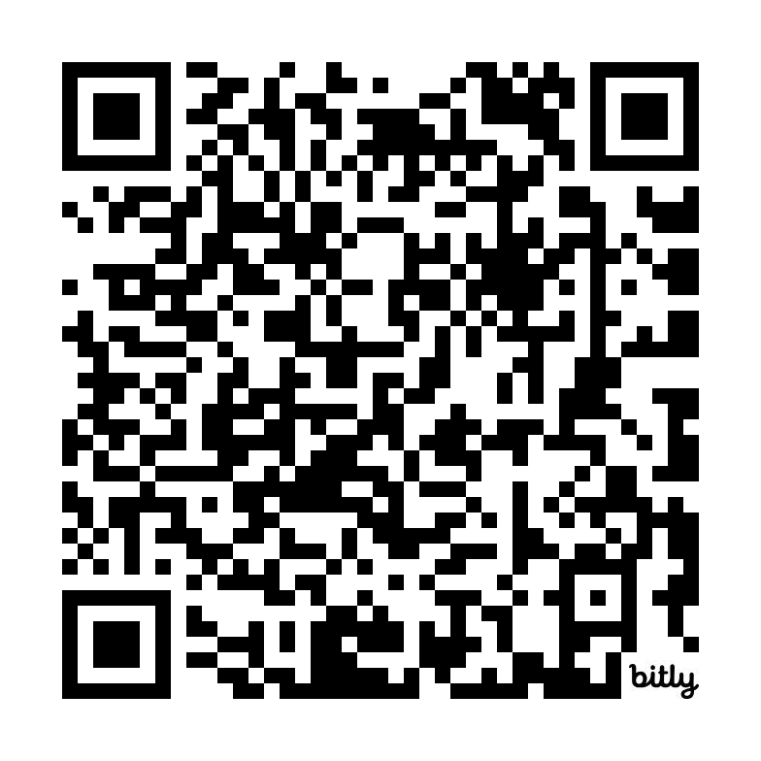
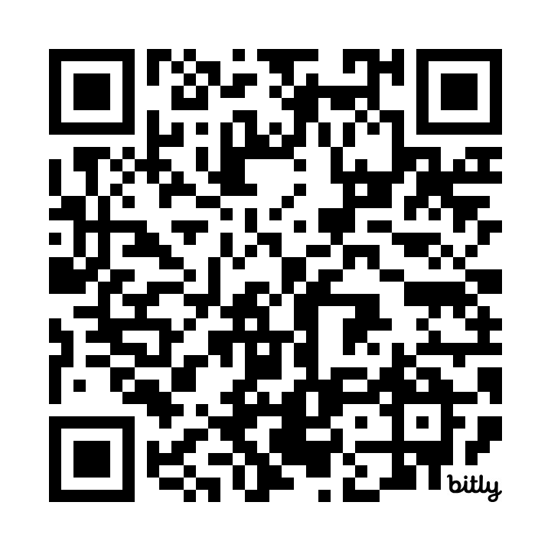
Modifying the Transition Readiness Assessment to better meet the needs of families with Medical Complexity.
Stephanie Pratt MSW, LMSW; Leslee Throckmorton Belzer PhD; Emily J Goodwin MD; Timothy E. Corden MD, MS
Children’s Mercy Kansas City, University of Missouri Kansas City
Background
Results
Discussion
The transition readiness assessment (TRA) is a tool used to identify transition gaps and goals during the journey from pediatric to adult care.
We noted that current surveys directed at caregivers of children with medical complexity (CMC) who will need full care/guardianship, did not adequately assess caregiver readiness.
Purpose: To modify the TRA survey given to CMC caregivers, so the instrument better reflects their lived experiences.
The workgroup and advisory council identified eight themes and 16 associated survey questions that specifically capture caregiver readiness.
The new assessment tool went into use April 1, 2024.
The approach resulted in themes and survey questions designed for CMC caregivers.
The transition and complex care teams at Children’s Mercy Kansas City (CMKC) have developed transition goals and caregiver education to address gaps identified through the new TRA.
CMKC will continue to evaluate the impact of the new survey questions, themes, and education on a successful health care transition.
Parent of CMC noted to their provider:
“ Going through the new CMC questions was a wake-up call for what she was going to have to start thinking about; she was appreciative of having been asked the questions.”
Themes Identified
Medical Care
Insurance
Guardianship
Education
Residential
Financial
Transportation
Adult Providers
6 Expanded Transition Goals with Supporting Education
School Planning
Accessible Transportation
Financial Planning
Medicaid Waivers
Supplemental Security Income
Residential Planning
Method
Convened a multidisciplinary workgroup that included CMC caregiver, medical providers, psychologists, RNs, care coordinators, clinical social workers, and transition leadership to identify themes to better address transition needs of CMC families.
Developed and elicited feedback about survey questions regarding transition readiness associated with each theme.
Presented the themes and questions to the CMC Parent Family Advisory Council for input and final approval. Developed goals around the questions and education to assist caregivers in obtaining goals.
Sample Questions
As my youth’s caregiver:
“I know what to do in the case of a medical emergency.
“I have a plan for finding guardianship or legal support when my youth turns 18.”
“I am aware of Medicaid, SSI/SSDI and waiver eligibility and how it will change as my youth becomes an adult.”
“I am aware of financial planning resources available.”
TRA
Education
For further information contact Stephanie Pratt,
LMSW Transition to Adulthood Program Manager.

