Slide 1
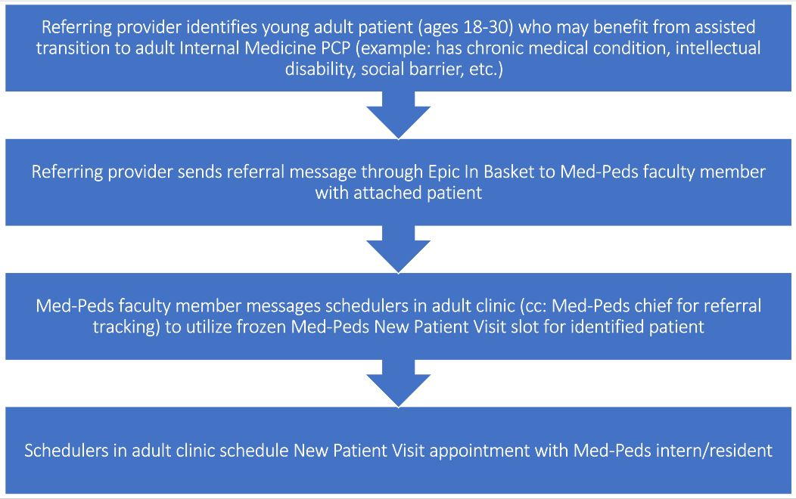
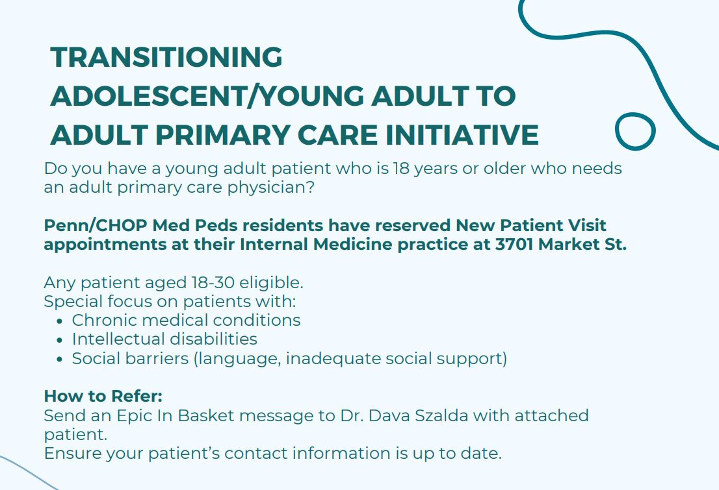
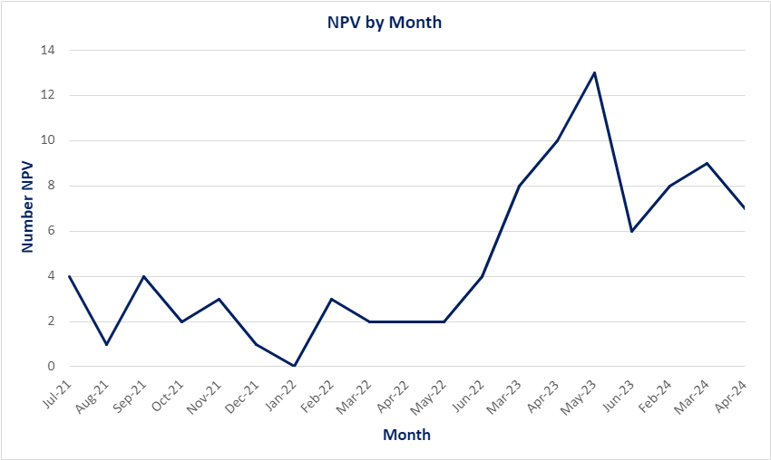
Transitioning Adolescents and Young Adults to Adult Primary Care:
A Resident-led Quality Improvement Initiative
Erin Tully MD, Madeline Chandra MD, Kevin Ackerman MD, Swati Goel MD, Dava Szalda MD University of Pennsylvania Health System and Children's Hospital of Philadelphia
Background
Project Design
Future Directions
Young adult patients often face challenges accessing care after transitioning from pediatric primary care.
Pediatric primary care providers cite difficulty identifying adult primary care providers for their young adult patients.
Prior QI work at our institution identified that Med-Peds residents and faculty feel more prepared to care for young adults and fill this role.
PDSA Cycle 1
PDSA Cycle 2
Subsequent cycles will aim to address additional barriers to accessing reserved appointment slots and further focus on patients with medical complexity, intellectual disabilities or social barriers to transition to adult primary care
Conclusions
Goals and Objectives
In the initial Plan-Do-Study-Act cycle, a new appointment template was created, and two appointment slots were held per week per Med-Peds resident for target patients. The referral process above was created to enable pediatric primary care providers to refer patients to be scheduled in these appointment slots. Cycle 1 occurred from March 2023 – June 2023.
In our second PDSA cycle, the depicted flyer was distributed to CHOP Primary Care practices to increase provider awareness of the QI initiative. Cycle 2 occurred from February 2024 – April 2024.
Adding reserved new patient visit appointment slots for young adult patients is an effective method to increase the number of young adult new patients seen by Med-Peds trainees.
Trainee QI activities can add robust access for young adult patients in adult primary care.
This project aimed to enhance access to adult primary care providers for young adults transitioning out of pediatric primary care. ​
Results
Setting and Methods
One internal medicine primary care clinic staffed in part by Med-Peds trainees was chosen for the study
Target patients included new patients between 18-30 years of age
Baseline data from the clinic was collected from July 2021-June 2022 to evaluate the number, demographics, and burden of chronic medical conditions of target patients seen by Med-Peds residents.
Using a QI approach, appointment availability/ability to efficiently schedule a new patient visit appointment was chosen as an intervention.
PDSA 1
PDSA 2
References
American Academy of Pediatrics; American Academy of Family Physicians; American College of Physicians-American Society of Internal Medicine. A consensus statement on health care transitions for young adults with special health care needs. Pediatrics. 2002 Dec;110(6 Pt 2):1304-6. PMID: 12456949.
McManus M, White P, Barbour A, Downing B, Hawkins K, Quion N, Tuchman L, Cooley WC, McAllister JW. Pediatric to adult transition: a quality improvement model for primary care. J Adolesc Health. 2015 Jan;56(1):73-8. doi: 10.1016/j.jadohealth.2014.08.006. Epub 2014 Oct 3. PMID: 25287984.
Nehring WM, Betz CL, Lobo ML. Uncharted Territory: Systematic Review of Providers' Roles, Understanding, and Views Pertaining to Health Care Transition. J Pediatr Nurs. 2015 Sep-Oct;30(5):732-47. doi: 10.1016/j.pedn.2015.05.030. Epub 2015 Jul 27. PMID: 26228310.
Okumura MJ, Kerr EA, Cabana MD, Davis MM, Demonner S, Heisler M. Physician views on barriers to primary care for young adults with childhood-onset chronic disease. Pediatrics. 2010 Apr;125(4):e748-54. doi: 10.1542/peds.2008-3451. Epub 2010 Mar 15. PMID: 20231189.
Szalda D, Steinway C, Greenberg A, Quinn S, Stollon N, Wu K, Trachtenberg S, Jan S. Developing a Hospital-Wide Transition Program for Young Adults With Medical Complexity. J Adolesc Health. 2019 Oct;65(4):476-482. doi: 10.1016/j.jadohealth.2019.04.008. Epub 2019 Jul 2. PMID: 31277993.
Figure 1. At baseline, Med-Peds residents saw 0.58 new patients 18-30 years each quarter of a year. During Cycle 1 (March-June 2023), the number of young adult new patient visits per month increased initially. Med-Peds residents saw 2.6 target patients per quarter, which represented an over 300% increase in new patients 18-30 years seen by Med-Peds residents. During Cycle 2 (February-April 2024), new patient visits per month increased slightly, though remained lower than the visits during Cycle 1.
Contact: tullye1@chop.edu
Authors have no financial relationships to disclose

