Slide 1
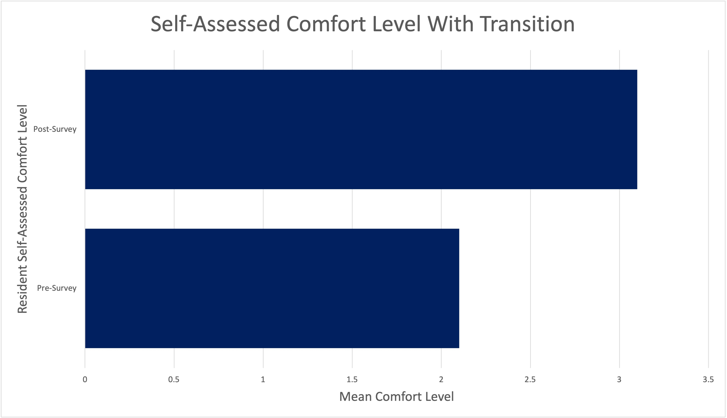
Interdisciplinary Education in Transition for Internal Medicine and Pediatrics Residents
Erin Tully, MD, Brittany Glassberg, MD, Dava Szalda, MD, and Rachel Hilburg, MD
University of Pennsylvania Health System/Children's Hospital of Philadelphia
Background
Curriculum Design
Future Directions
Healthcare providers report lack of training in transition and caring for youth with special healthcare needs as a barrier to successful transition
Combined Internal Medicine-Pediatric (Med-Peds) residents have a unique niche in transitions of care but may receive varied training in facilitating transition
Transition 101 lecture included definitions of healthcare transition, the core elements of transition, variations and barriers in implementing transitions practices, and a framework for facilitating transition
Discussion session included interdisciplinary team members from the ACTT team at Penn/CHOP
Assess resident satisfaction with curriculum addition
Add practice with creating transition plans and increase experiential learning in future curriculum
Conclusions
Goals and Objectives
The introduction of a didactic and interdisciplinary discussion session into the Med-Peds residency ambulatory and advocacy curriculum was met with high participation and satisfaction and can be a successful approach to incorporating an interdisciplinary transition curriculum into the med peds residency experience
Introduce a transition curriculum with an interdisciplinary approach to Med-Peds residents at Penn/CHOP​
Results
"I love the idea of incorporating more education on transitions for med peds residents"
"This is crucial! Definitely should be a large part of the curriculum as this is one of the fields that we are expected to be experts at"
Setting and Methods
Med-Peds residents in their first, second, and third year received a 1-hour didactic session with an additional hour of discussion with a member of the Adult Care and Transition Team (ACTT) within their ambulatory block during the 2023-2024 academic year
Residents were surveyed before and after the session to assess knowledge acquisition, comfort level with the transition process, and comments/suggestions
Members of the ACTT team were informally surveyed for satisfaction with participation in the curriculum
References
American Academy of Pediatrics; American Academy of Family Physicians; American College of Physicians-American Society of Internal Medicine. A consensus statement on health care transitions for young adults with special health care needs. Pediatrics. 2002;110(6 pt 2):1304 –1306
Sharma N, O'Hare K, Antonelli RC, Sawicki GS. Transition care: future directions in education, health policy, and outcomes research. Acad Pediatr. 2014 Mar-Apr;14(2):120-7. doi: 10.1016/j.acap.2013.11.007. PMID: 24602574; PMCID: PMC4098714.
Berens JC, Jan S, Szalda D, Hanna CM. Young Adults With Chronic Illness: How Can We Improve Transitions to Adult Care? Pediatrics. 2017 May;139(5):e20170410. doi: 10.1542/peds.2017-0410. Epub 2017 Apr 12. PMID: 28557765.
Patel MS, O’Hare K. Residency training in transition of youth with childhood-onset chronic disease. Pediatrics. 2010;126(suppl 3): S190–S193.
Okumura MJ, Kerr EA, Cabana MD, Davis MM, Demonner S, Heisler M. Physician views on barriers to primary care for young adults with childhood onset chronic disease. Pediatrics. 2010;125(4).
Melgar T, Chamberlain JK, Cull WL, et al. Training experiences of US combined internal medicine and pediatrics residents. Acad Med.2006;81:440–446
Contact: erin.tully@pennmedicine.upenn.edu

